Slide 1
70-462 Project
Anamika Agarwal, Gordon Wang, Samantha Wu

Slide 2
Agenda
Problem
Our Recommendation- Ideal Vaccination Coverage Target
Analysis
Recommended Vaccination Programs
Risks and Opportunities

Slide 3


Is Increasing Vaccination Coverage Worth It?
Current vaccination programs have limited outreach
Seasonal nature of the influenza virus demands yearly flu shots

Slide 4
Drivers of Disease Propagation
Reproduction Number (R₀)- Expected number of secondary cases produced by a single infected individual
Roughly 1.5 for this city
Dependent on factors such as average number of interactions of individuals per day, and number of days it takes for an infected individual to become immune
Vaccine Effectiveness- How well an immunized population is protected from an infection
Roughly 47% for 2019 flu vaccine
Notes:
Verbally mention- Reproduction number is directly related to #infected individuals
Vaccine effectiveness is inversely related to #infected individuals

Slide 5
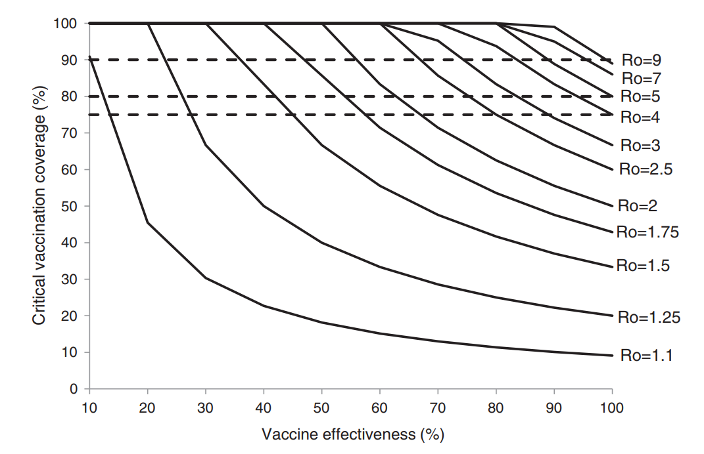
Ideal Vaccination Coverage Rate
Source: https://doi.org/10.1016/j.ypmed.2012.02.015
Notes:
Our city is currently at

Slide 6
Analysis
Measure | 0% | 40% | 71% (Ideal rate)
Mean | 90,155 | 50,688 | 21,689
5th Percentile | 86,945 | 67,273 | 19,427
95th Percentile | 92,760 | 72,863 | 23,478
Standard Deviation | 1,869 | 1,788 | 1,245

Slide 7
Analysis
Measure | 0% | 40% | 71% (Ideal rate)
Mean | 90,155 | 50,688 | 21,689
5th Percentile | 86,945 | 67,273 | 19,427
95th Percentile | 92,760 | 72,863 | 23,478
Standard Deviation | 1,869 | 1,788 | 1,245

Slide 8
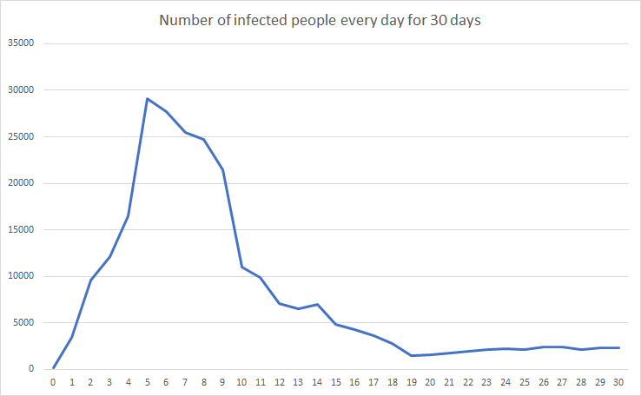
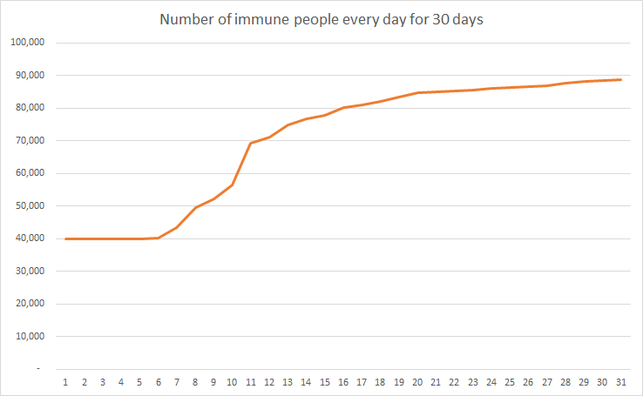
Disease Propagation with 40% Vaccination Coverage

Slide 9
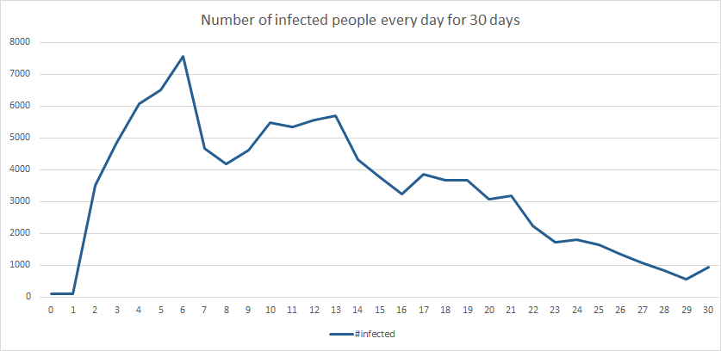
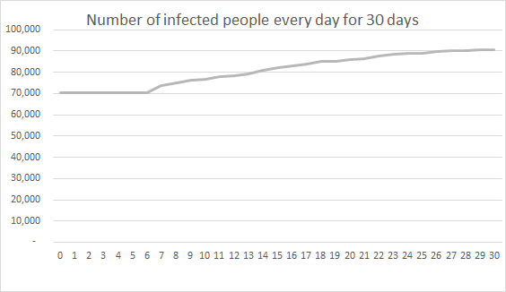
Disease Propagation with Ideal Vaccination Coverage

Slide 10
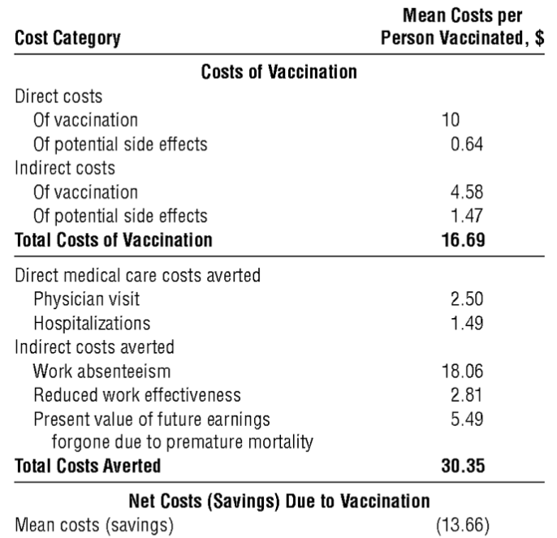
Savings per person vaccinated
Source: doi:10.1001/archinte.161.5.749
Notes:
Cost - $1 to 6 million per 100,000 in US at the current average vaccination coverage rate of 40%

Slide 11
NYC’s vaccination success
71.5% vaccination rate of children aged 6 months to 17 years
44% vaccination rate of adults aged 18 to 64
66% vaccination rate of adults aged 65+
Source: New York City Department of Health and Mental Hygiene
Notes:
Cost: covered by insurance to $40
Available in drug stores, supermarkets, wholesale clubs, doctor’s offices, pharmacists

Slide 12
Market the vaccine like NYC does
Low cost and widely available vaccines
Many forms of marketing
Posters on buses, subways
Ads on TV, YouTube
Ads present hard facts like how many people are killed by the flu each year, and how to prevent getting sick in addition to getting the vaccine
Letters to parents from schools encouraging all students to be vaccinated
Mandatory vaccination of students aged 6 months to 5 years
Source: New York City Department of Health and Mental Hygiene
Notes:
Cost: covered by insurance to $40
Available in drug stores, supermarkets, wholesale clubs, doctor’s offices, pharmacists

Slide 13
Risks of our recommendation
Given that vaccination effectiveness is less than 50%, coverage needs to be very high
Due to seasonal nature of flu, population needs to be vaccinated every year
Difficult to achieve a high vaccination coverage rate
Notes:
Low vaccination effectiveness
During years when the flu vaccine is not well matched to circulating influenza viruses, it is possible that little or no benefit from flu vaccination may be observed. During years when there is a good match between the flu vaccine and circulating viruses, it is possible to measure substantial benefits from flu vaccination in terms of preventing flu illness and complications.
2. Seasonal Nature of Flu:
3. Difficulty to achieve a high vaccination coverage rate:
https://www.ifpma.org/wp-content/uploads/2016/01/IFPMA-IVS-Eng-FactSheet3-01.13.pdf
https://jamanetwork.com/journals/jamainternalmedicine/fullarticle/647568

Slide 14
Opportunities of our recommendation
Protects even people who haven’t been vaccinated through the herd effect
Benefits city economically through reducing costs of flu
Healthcare
Individual
Societal
Notes:
Point 1: Herd Immunity: large proportion vaccinated = protection of susceptible people from infection.
INCREASE in proportion of population vaccinated = DECREASE in likelihood that susceptible people will come into contact with the disease.
Stops diseases from spreading since large numbers of people are immune, breaking the chain of infection, because each case of flu only leads to a single new case, leading to infection to stabilize within population.
Point 2:
Healthcare: fewer visits, fewer hospitalizations
Individual: prevention of work loss due to abstenteeism, leading to more earnings for the person.
Societal: Healthier individuals = Lower rates of reduced work effectiveness = preserving efficiency of workers for companies, increasing economic productivity, leading to growth of the city.

Slide 15
Appendix

Slide 16
Our recommendation- Appendix
Optimal coverage
R0 = (Probability of getting infected)*(Number of interactions/day)*(Days required to become immune)
= (0.1)*(3/day)*(5)
= 1.5
Herd Protection Rate = (1 - (1/Reproduction number))/Vaccine Effectiveness
= 0.33/0.47 = 0.71

Slide 17
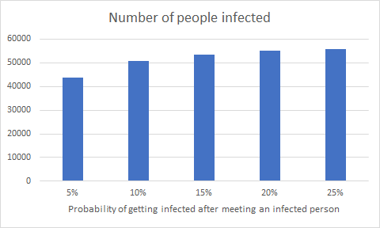
Sensitivity Analysis
The probability does not affect disease propagation as drastically after a threshold of 10%

Slide 18
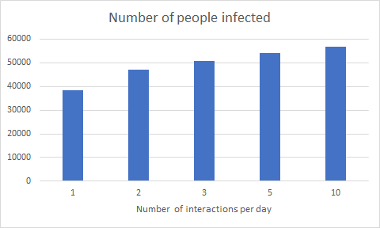
Sensitivity Analysis
The number of interactions per day does not affected disease propagation as drastically after a threshold of 3 interactions per day

